Slide 1

Group-4
Black & Decker Corporation
Abhinav Bansal (PGP38163)
Amrutha Palli (PGP38173)
Phaneendra Maseedu (PGP38192)
Vemula Akshara (PGP38212)
Utkarsh Singh (PGP38213)
Manideep Vulli (PGP38214)
Sunny Ranjan (PGP38496)

Slide 2
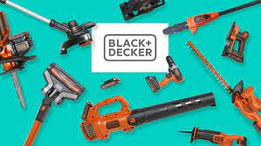
Background
Founded in 1910 by Duncan Black & Alonzo Decker Sr.
Received patent for world’s first portable power drill
World’s largest producer of Power Tools
Moved from “garage to house” - introduced Dustbuster in 1979
Bought General Electric House ware Division in 1984

Slide 3
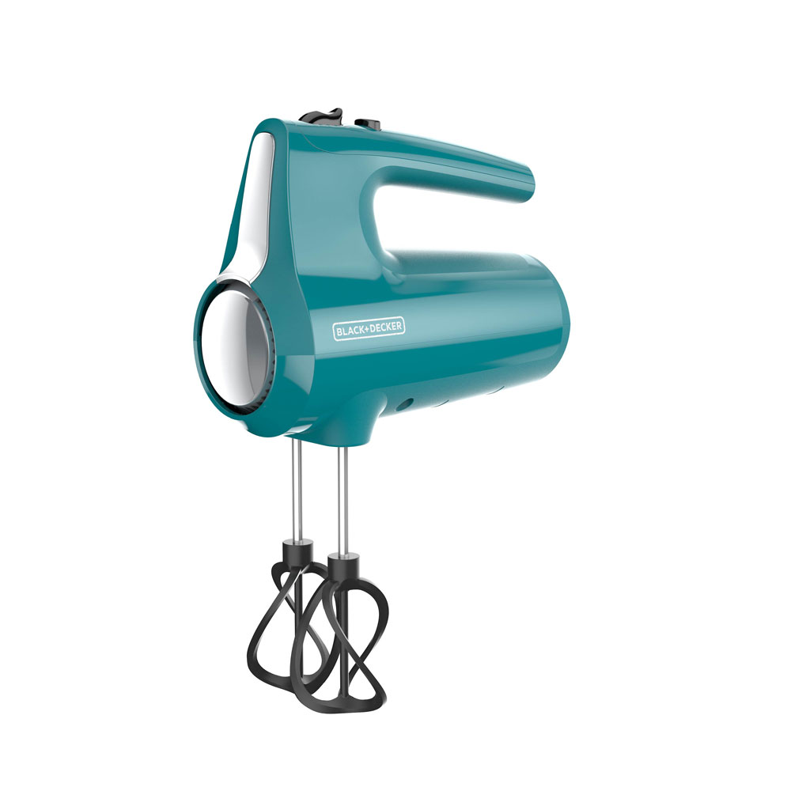
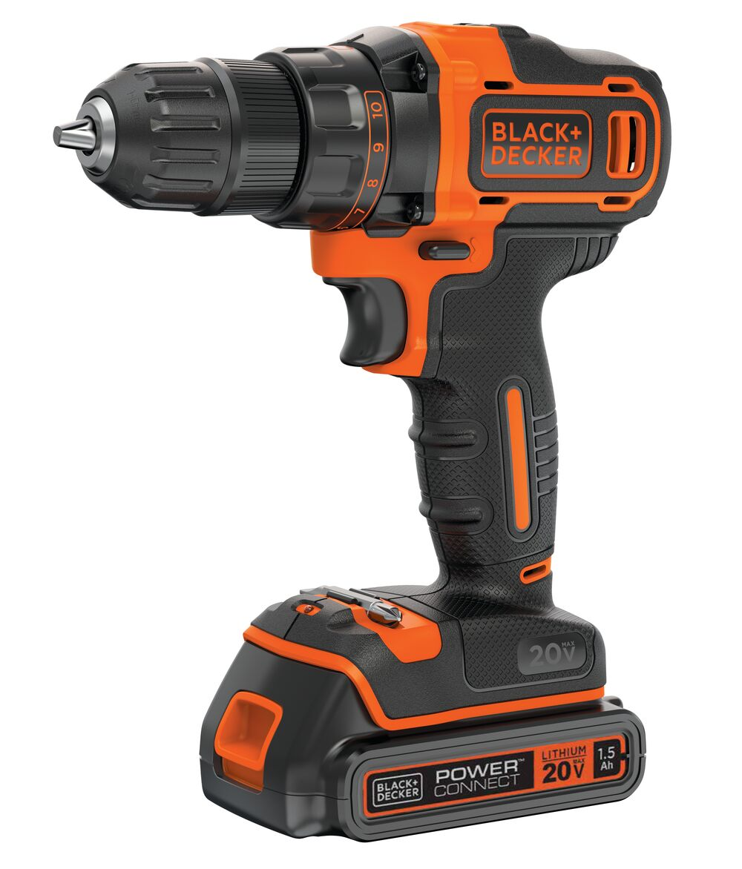
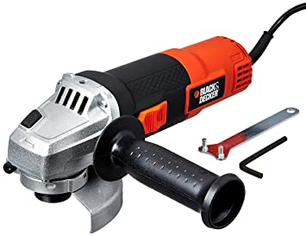
Black & Decker Products
Consumer Products | Tradesmen Products | Industrial Products
At Home use Used for Household Applications | Professional Use Used by “tradesmen” - electricians, plumbers, etc. | Professional Use Corporation purchasing tools for employee usage

Slide 4

Major Competitors
Makita Electric of Japan
Took over the “Tradesman” products
80% share in cordless drills
50% of the entire Tradesman product sector
Other competitors: Milwaukee Electric, Ryobi, Skil, etc.

Slide 5
Revenue of Black & Decker
1980s were volatile for B&D
19% increase in revenue BUT sales stagnated through 1983
From 1981 to 1985, company lost money
B&D acquired Emhart Corporation (doubled their revenue); Kwikset Locks and Price Pfisters Faucets
These acquisitions raised long-term debt to $4.2 billion

Slide 6
Problem Statement
Management Decision Problem :
How to increase Black & Decker’s market Share in Tradesmen Products?
Three Options Available:
Harvest Tradesmen Channels
Sub-Branding
Drop B&D brand name from Professional Tradesmen Segment

Slide 7
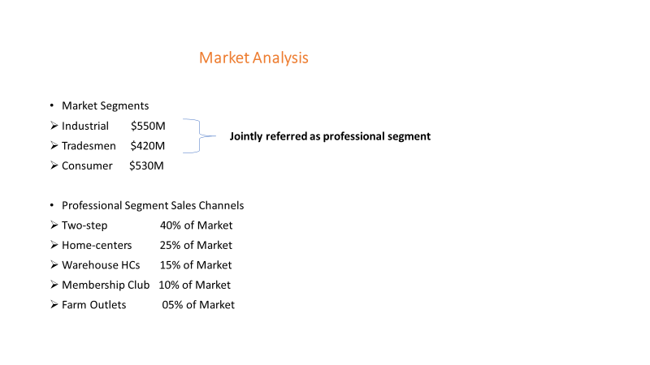
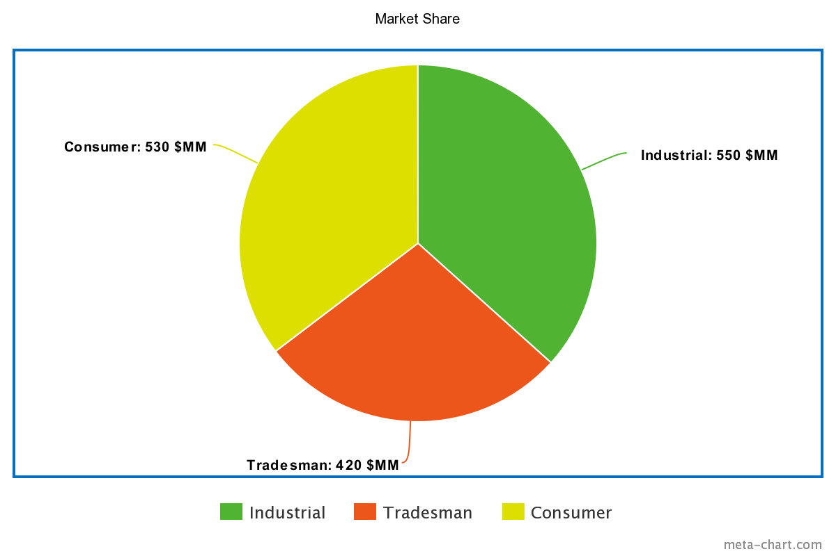

Slide 8
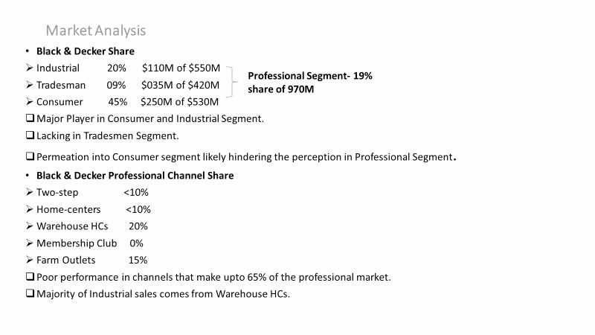

Slide 9
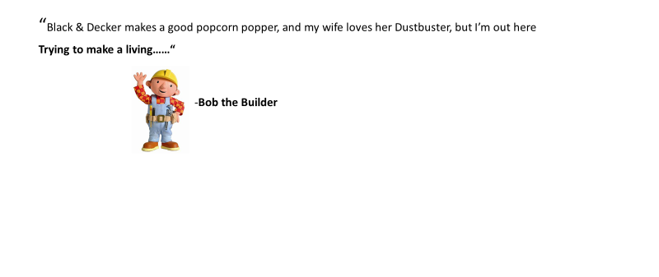
Perception among Tradesmen

Slide 10
The Professional Segment Buyer
Brand Perception
Strength as consumer brand, not necessarily good for Tradesman Segment
Average spending of tradesmen was $1000 per year
HIGHEST
LOWEST
Makita
Milwaukee
Bosch
Hitachi
Porter Cable
Panasonic
Black & Decker
Ryobi
Skil
Cratfsman
Wen

Slide 11
Colour Perceptions
Professional Grade Equipment | Consumer Grade
Makita | Black & Decker
Milwaukee | Craftsman
Bosch | Skil
Hitachi | Wen
Black & Decker | Private Label Products

Slide 12
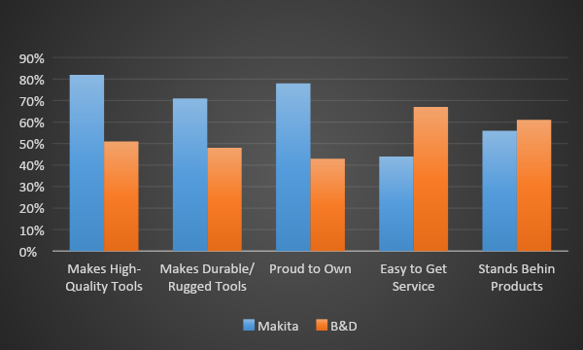
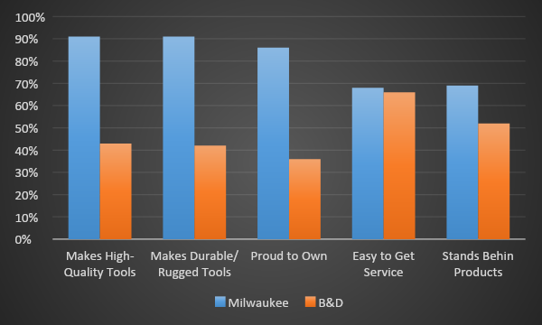
Study regarding agreeableness of specific attributes
People who prefer Makita
People who prefer Milwaukee

Slide 13
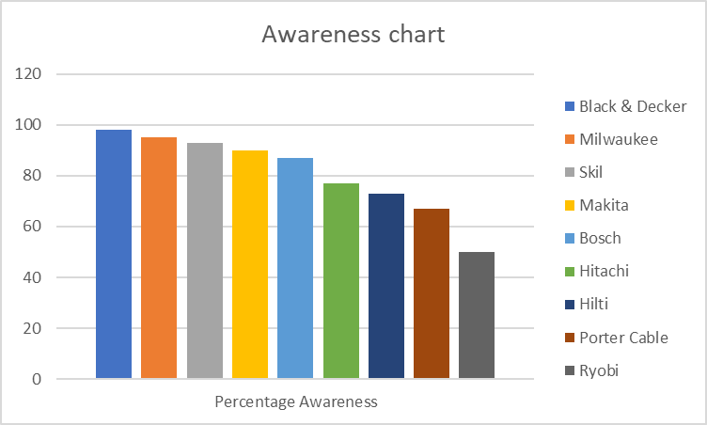
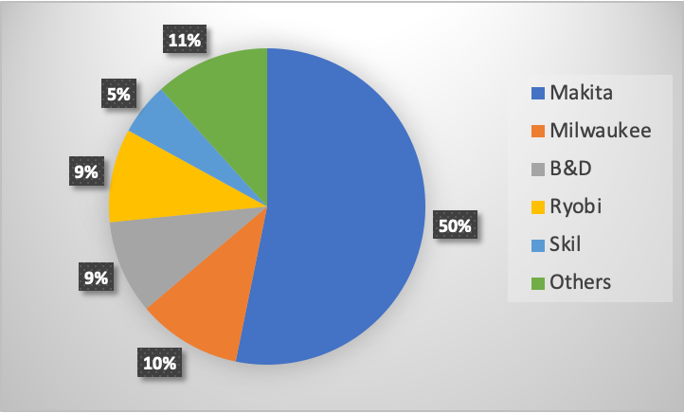
Awareness of Power Tool Suppliers among Tradespeople

Slide 14
Option 1
Harvest Professional-Tradesmen Channels
Pros | Cons
Increase Profitability | Sacrifice growth in market share in one of the fastest growing sectors
Option 1 is not viable

Slide 15
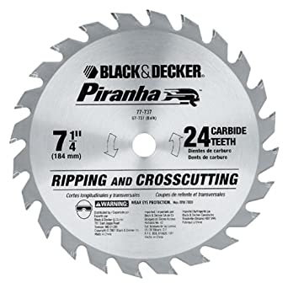
Option 2
2. Sub Branding
Pros | Cons
Successful in the past with spacemaker line of products | Perception will not be improved as Black and Decker name negative perception is still associated with product

Slide 16
Option 3
Drop Black & Decker name from the professional tradesmen segment
Pros | Cons
Perception improves as black and decker name is dropped Highly percieved brand like Dewalt available and back by black and decker service | De walt was never associated with tools segment and hence takes time

Slide 17

Perception of Dewalt
Identified as | Percent purchase interest
Dewalt | 51%
Dewalt-Serviced and Distributed by B&D | 58%
Dewalt-manufactured Serviced and Distributed by B&D | 53%

Slide 18
THANK YOU!

